Slide 1





HOTELREVAI AI-DRIVEN REVENUE ANALYSIS FOR HOTELS

Slide 2

TEAM MEMBERS
ANKIT KUMAR
BALASUNDARI S
JANNIGORLA VENU
MANJEET SINGH
NIHITH AITHA
STENY RESHMI V
UNDER GUIDED BY:
MUKILAN SELVARAJ

Slide 3



OVERVIEW
INTRODUCTION
PROJECT OVERVIEW
KEYFEATURES
MILESTONE
OUTCOME
CONCLUSION

Slide 4



INTRODUCTION
This Business Intelligence solution, built in Power BI, helps hotels analyze and improve their performance by tracking key KPIs such as occupancy rate, revenue, and guest behavior. It uses past booking data to identify current trends and predict future performance. The solution involves data collection, cleaning, modeling, and visualization, providing interactive dashboards that deliver clear and actionable insights.
PROJECT OVERVIEW
Analyze hotel bookings, customers, and revenue.
Use Power BI dashboards for insights.
Support pricing, promotions, and upselling decisions.

Slide 5







TECHNOLOGIES USED
BUSINESS INTELLIGENCE TOOLS - POWERBI
DATA TRANSFORMATION - POWER QUERY
PYTHON BASED DATA APP - STREAMLIT,NUMPY,PANDAS

Slide 6

•Cleaned & transformed booking/room data.
•Built Star Schema with fact & dimension tables.
•Validated relationships.
MILESTONE 1
MILESTONE 5
•Dashboard with pricing tiers, upsell offers.
•Seasonal promotions added.
•Delivered final reports.
•Dynamic Power BI dashboard.
•Metrics: Occupancy %, ADR, RevPAR.
•Seasonal & room-type insights.
MILESTONE 2
•Segmented guests by demographics & purpose.
•Personas: Family Loyalist, Solo Explorer, Corporate Guest.
•Helped in targeted marketing.
MILESTONE 3
•Used historical data to predict occupancy.
•Lead time analysis & cancellation heatmaps.
•Identified risk patterns.
MILESTONE 4

Slide 7
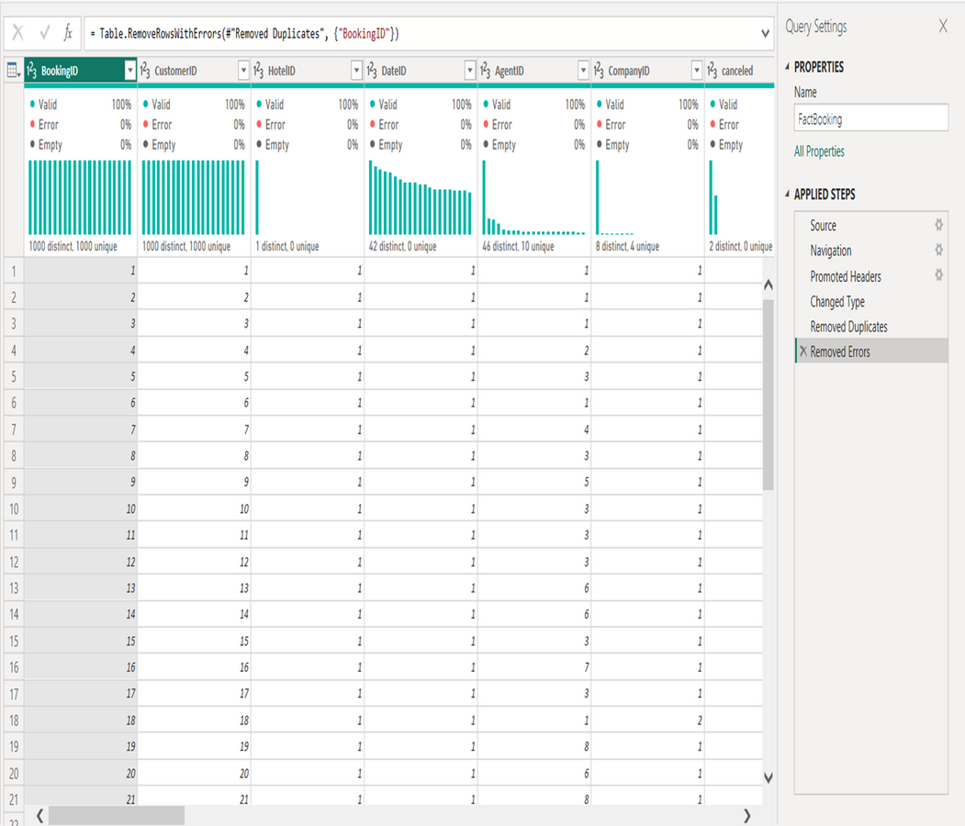
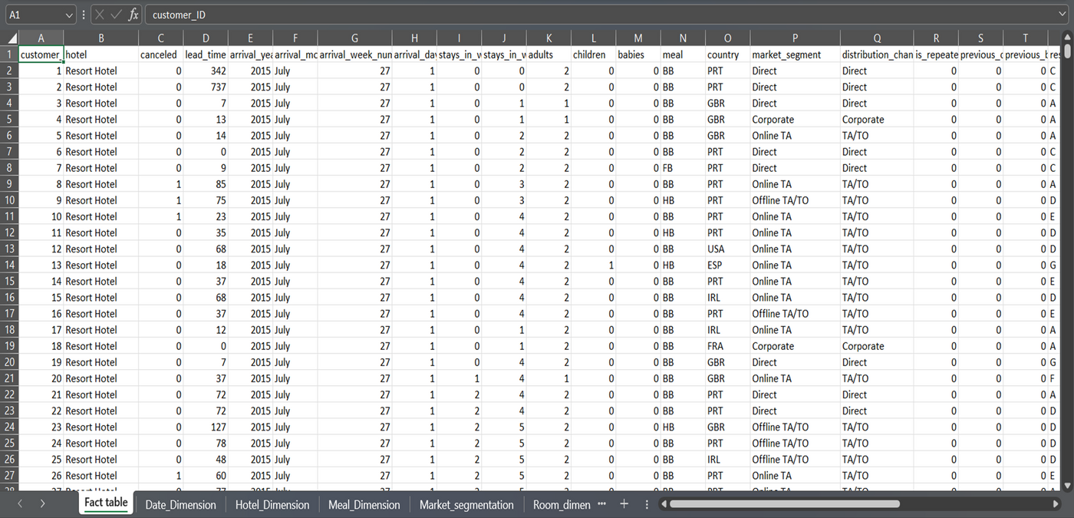
DATASET OVERVIEW AND DATA PREPARATION
CORE DATA:
•Booking ID, Customer ID, Booking Dates.
CHALLENGES:
•Missing values, duplicates, wrong data types.
DATA PREPARATION STEPS:
•Removed irrelevant columns.
•Handled null values.
•Corrected data types.
Final clean & consistent dataset

Slide 8
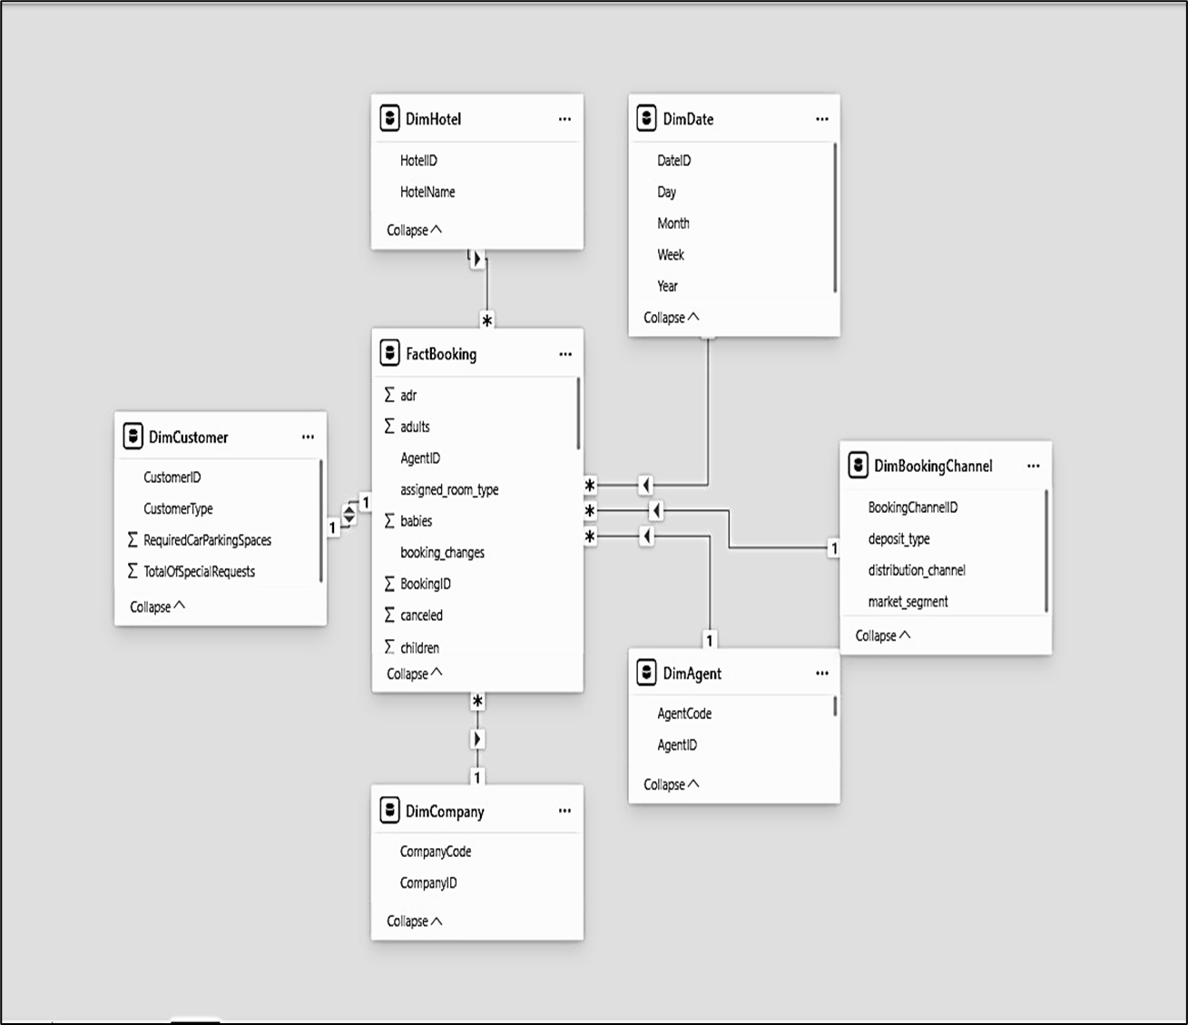
STAR SCHEMA
FACT TABLE:
•Fact_Bookings → Key transaction data.
DIMENSION TABLES:
•Dim_Guests, Dim_Rooms, Dim_Hotels, Dim_Dates, Dim_BookingSource.
RELATIONSHIPS:
•One-to-Many (Fact_Bookings → Dimensions).
•Ensures data integrity & proper analysis.

Slide 9
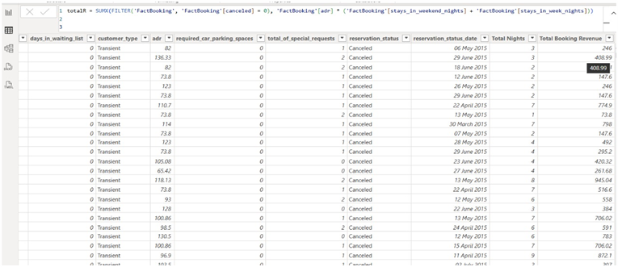
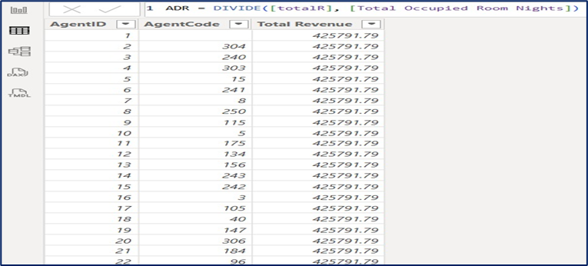
KEY REVENUE MATRICS
NEW METRICS INTRODUCED:
•Occupancy % → % of rooms occupied.
•ADR (Average Daily Rate) → Avg revenue per occupied room.
•RevPAR (Revenue per Available Room) → Combines ADR + Occupancy.
OPTIMIZED FIELDS:
•Created Booking Duration (length of stay).
•Transformed date fields for time-based analysis.

Slide 10
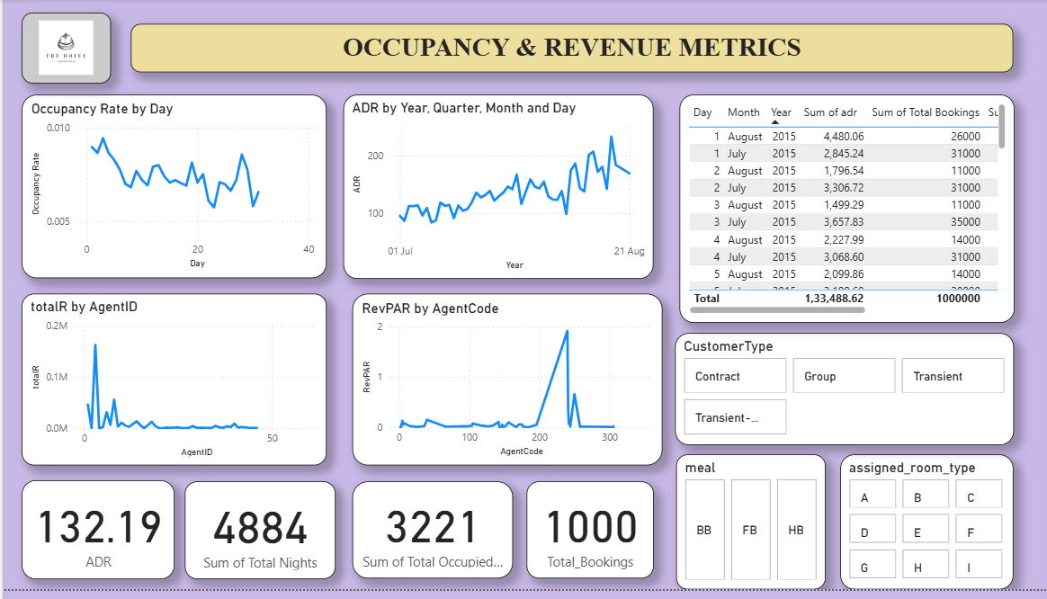
MILESTONE 2 OUTCOME

Slide 11

INTERACTIVE DASHBOARD REVENUE & OCCUPANCY ANALYSIS
METRICSDISPLAYED:
•Occupancy %, ADR, RevPAR, Total Revenue.
REVENUE PERFORMANCE:
•ADR → Pricing power indicator.
•RevPAR → Overall revenue efficiency.
OCCUPANCY ANALYSIS:
•Shows seasonal trends.
•Measures weekend vs weekday performance.
•Helps assess marketing campaign impact.

Slide 12

INTERACTIVE FILTERING DATA PREPARATION & BUSINESS IMPACT
INTERACTIVE FILTERING:
Slicers for room type, location, booking source.
DATA PREPARATION:
Handle missing demographic fields and standardize categories.
Group age into Youth, Adult, and Senior categories.
Create Loyalty Flag (New vs Returning).
Normalize data for clustering (if applied).
DEVELOPMENT HIGHLIGHTS:
Raw data → Actionable dashboard.
Strong data model built.
BUSINESS IMPACT:
Data-driven pricing decisions.
Trend identification.
Foundation for future AI-driven forecasting.

Slide 13
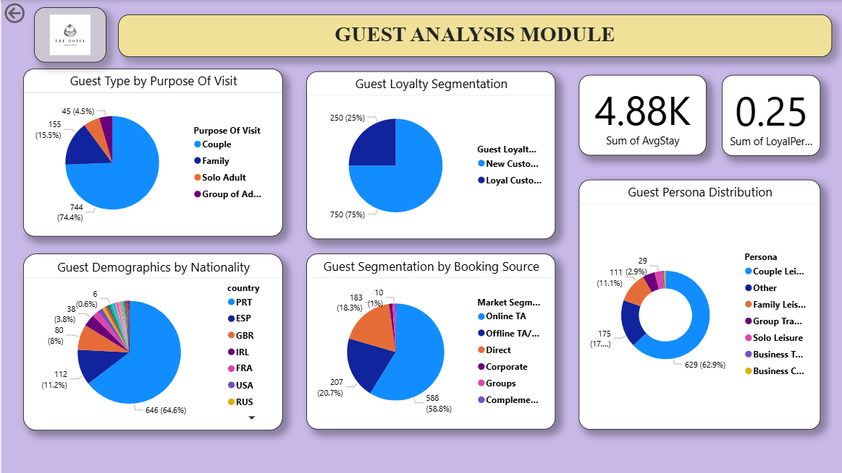
MILESTONE 3 OUTCOME

Slide 14

FEATURE ENGINEERING & INSIGHTS
Guest personas were created by mapping the purpose of visit, age group, and loyalty (e.g., Family Loyalist, Solo Explorer, Corporate Guest). Insights suggest launching couple-oriented packages to boost off-peak bookings, upselling premium rooms to loyal guests for higher ADR, and offering direct booking incentives to reduce OTA costs and improve profitability.

Slide 15
KEY METRICS & INSIGHTS
Average Stay: 4.9 days
Booking Cancellations: 25%
Occupancy: Slight downward trend → predict peaks & lows
Cancellations: Declining month by month → improved stability
Room Types: F, D, E = longer stays (5–6 days),L = short (~1.5 days)
Customer Mix: Contract customers dominate (473) → target promotions
Stay Pattern: Contract → longer stays (F, D, A),Transient/Group → moderate stays

Slide 16
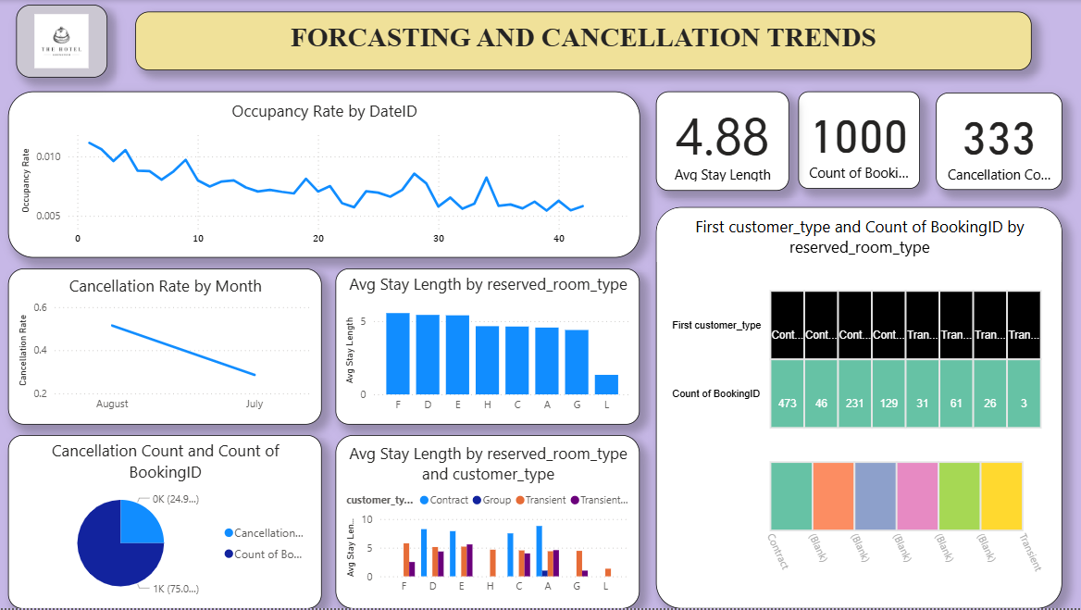
MILESTONE 4 OUTCOME

Slide 17

REVENUE STRATEGY DASHBOARD
METRICS:
ADR, Total Bookings, Ancillary %, Total Revenue, Avg Stay Length
VISUALS:
- Pricing Tier vs Revenue
- ADR & RevPAR by Month
- Ancillary Revenue by AgentCode

Slide 18
REVENUE STRATEGY INSIGHTS & BUSINESS IMPACT
FINDINGS:
ADR & RevPAR highest in Summer
Revenue highest in premium tier
Negative ancillary revenue from 1 agent
ACTIONS:
Adjust pricing
Investigate agent issue
Optimize seasonal packages
IMPACT:
Targeted marketing
Personalized offers
Improved guest satisfaction & revenue
FUTURE:
AI-driven forecasting

Slide 19
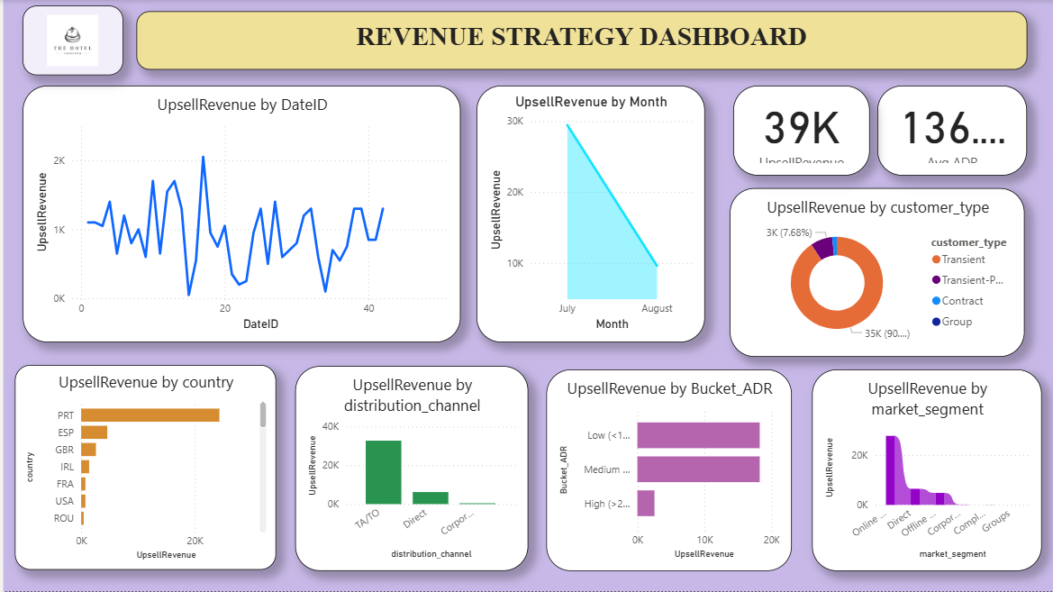
MILESTONE 5 OUTCOME

Slide 20
AI PART
This module applies Facebook Prophet for time-series forecasting to predict hotel revenue, cancellations, and occupancy for the next 90 days.
The process starts by loading and cleaning booking data, then grouping by reservation dates to prepare it for modeling.
The Prophet model identifies patterns like seasonality and trends, generating accurate future predictions.
Using Streamlit, the results are shown as interactive dashboards with summary metrics, trend charts, and downloadable forecast CSVs.
This helps hotel managers plan capacity, adjust pricing, reduce cancellations, and make data-driven decisions to boost revenue and guest satisfaction.

Slide 21
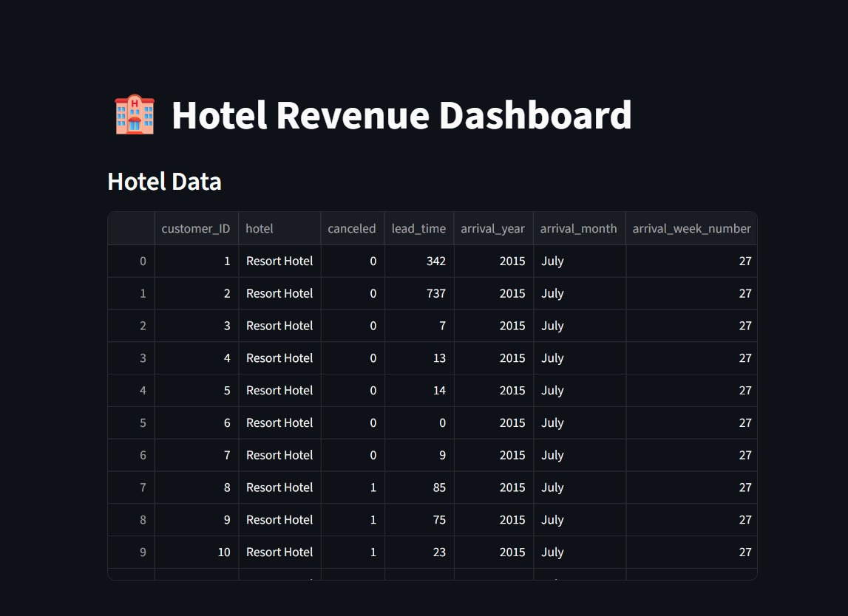

Slide 22
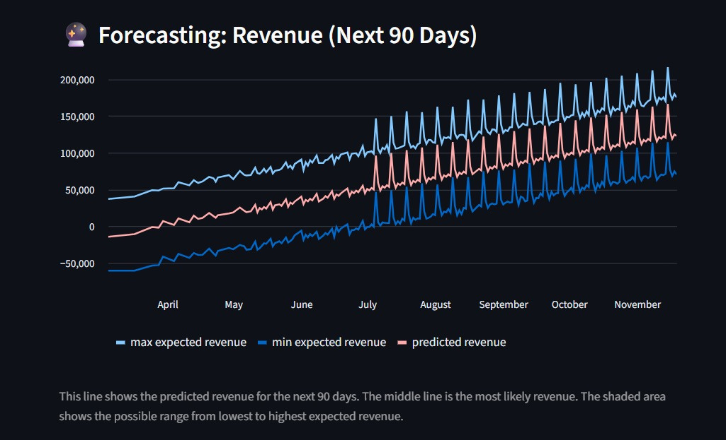

Slide 23
CONCLUSION
Milestone 1:
Cleaned and organized booking data, fixed errors, and built a Star Schema for accurate reporting.
Milestone 2:
Created an interactive Power BI dashboard with key metrics (Occupancy %, ADR, RevPAR) and filters for better decision-making.
Milestone 3:
Analyzed guest personas and booking behavior to support targeted marketing and personalized services.
Milestone 4:
Developed forecasting models to predict occupancy and revenue, helping reduce cancellation risks.
Milestone 5:
Integrated all insights into a final dashboard for pricing, promotions, and performance comparison — enabling smarter decisions and higher revenue.

Slide 24

THANKYOU

